Slide 1

Chapter 6
Bandwidth Utilization:
Multiplexing and Spreading
BY
NTR
6.1
Copyright © The McGraw-Hill Companies, Inc. Permission required for reproduction or display.

Slide 2

Note
Bandwidth utilization is the wise use of available bandwidth to achieve specific goals.
Efficiency can be achieved by multiplexing; i.e., sharing of the bandwidth between multiple users.
6.2

Slide 3
6-1 MULTIPLEXING
Whenever the bandwidth of a medium linking two devices is greater than the bandwidth needs of the devices, the link can be shared. Multiplexing is the set of techniques that allows the (simultaneous) transmission of multiple signals across a single data link. As data and telecommunications use increases, so does traffic.
Topics discussed in this section:
Frequency-Division Multiplexing
Wavelength-Division Multiplexing
Synchronous Time-Division Multiplexing
Statistical Time-Division Multiplexing
6.3

Slide 4
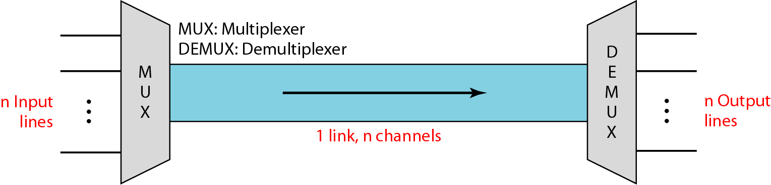
Figure 6.1 Dividing a link into channels
6.4

Slide 5
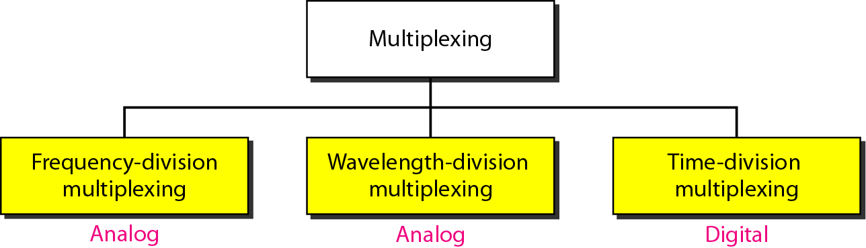
Figure 6.2 Categories of multiplexing
6.5

Slide 6
Frequency-division multiplexing
FDM is an analog multiplexing technique that combines analog signals.
FDM is an analog technique that can be applied when the bandwidth of a link (in hertz) is greater than the combined bandwidths of the signals to be transmitted.
6.6

Slide 7
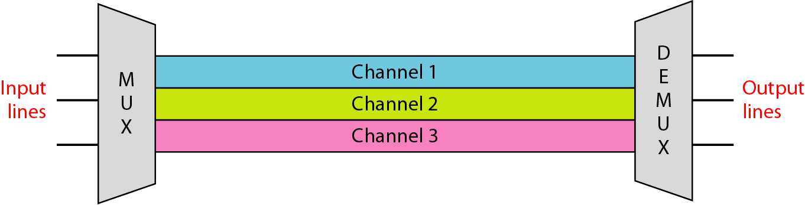
Figure 6.3 Frequency-division multiplexing (FDM)
Link🡪 physical path
Channel🡪 portion of a link that carries a transmission between a given pair of lines
6.7

Slide 8
Frequency-division multiplexing
Signals generated by each sending device modulate using different carrier frequencies.
These modulated signals are then combined into a single composite signal that can be transported by the link that has enough bandwidth to accommodate it.
Channels can be separated by strips of unused bandwidth—guard bands—to prevent signals from overlapping.
6.8

Slide 9
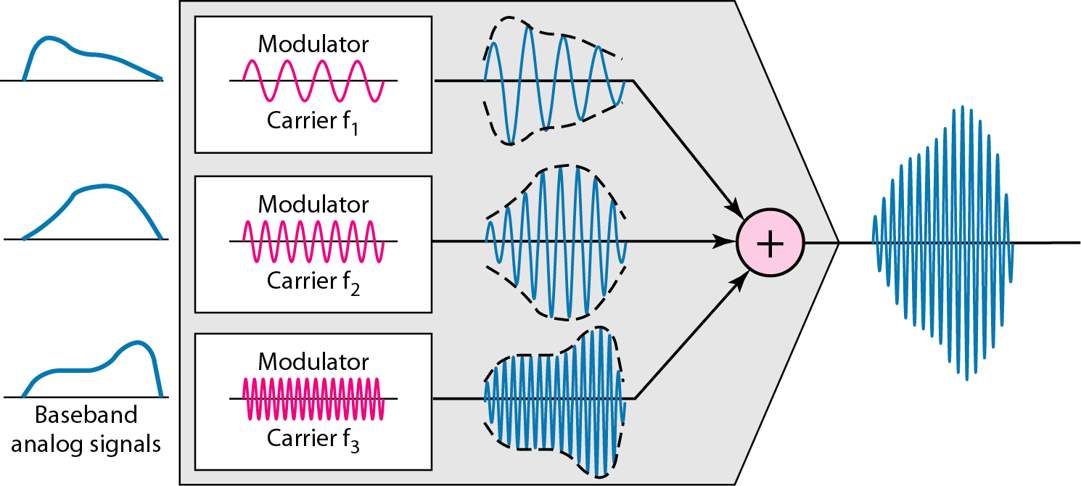
Figure 6.4 FDM process
6.9

Slide 10
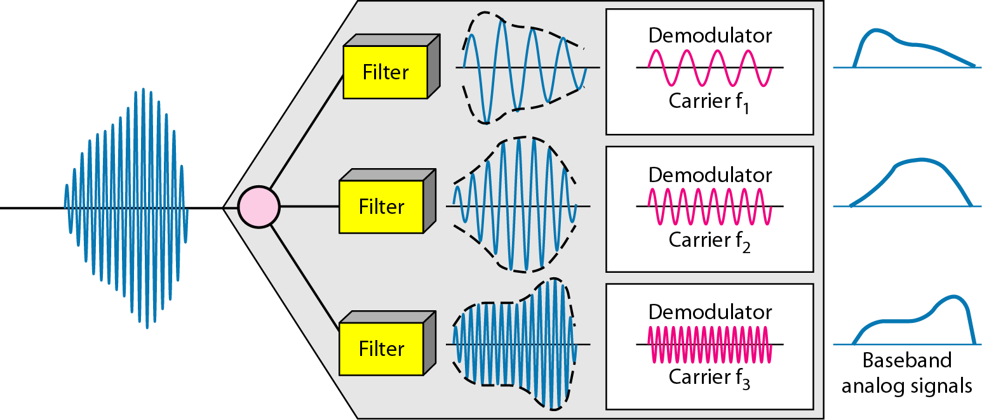
Figure 6.5 FDM demultiplexing example
6.10

Slide 11
Example 6.1
Assume that a voice channel occupies a bandwidth of 4 kHz. We need to combine three voice channels into a link with a bandwidth of 12 kHz, from 20 to 32 kHz. Show the configuration, using the frequency domain. Assume there are no guard bands.
Solution
We shift (modulate) each of the three voice channels to a different bandwidth, as shown in Figure 6.6. We use the 20- to 24-kHz bandwidth for the first channel, the 24- to 28-kHz bandwidth for the second channel, and the 28- to 32-kHz bandwidth for the third one. Then we combine them as shown in Figure 6.6.
6.11

Slide 12
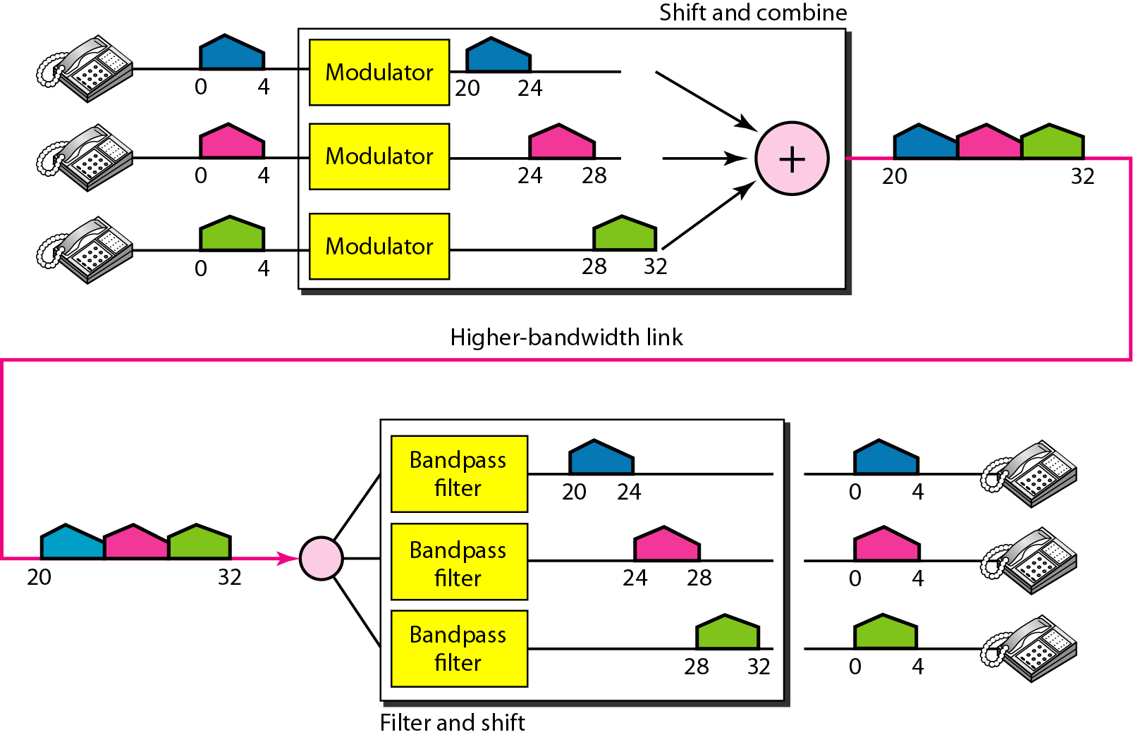
Figure 6.6 Example 6.1
6.12

Slide 13
Example 6.2
Five channels, each with a 100-kHz bandwidth, are to be multiplexed together. What is the minimum bandwidth of the link if there is a need for a guard band of 10 kHz between the channels to prevent interference?
Solution
For five channels, we need at least four guard bands. This means that the required bandwidth is at least
5 × 100 + 4 × 10 = 540 kHz,
as shown in Figure 6.7.
6.13

Slide 14
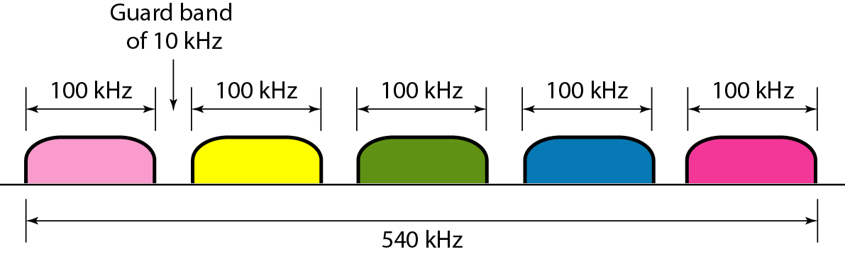
Figure 6.7 Example 6.2
6.14

Slide 15
Example 6.3
Four data channels (digital), each transmitting at 1 Mbps, use a satellite channel of 1 MHz. Design an appropriate configuration, using FDM.
Solution
The satellite channel is analog. We divide it into four channels, each channel having 1M/4=250-kHz bandwidth.
Each digital channel of 1 Mbps must be transmitted over a 250KHz channel.
Each digital channel of 1 Mbps is modulated so that each 4 bits is modulated to1 Hz. One solution is 16-QAM modulation. Figure 6.8 shows one possible configuration.
6.15

Slide 16
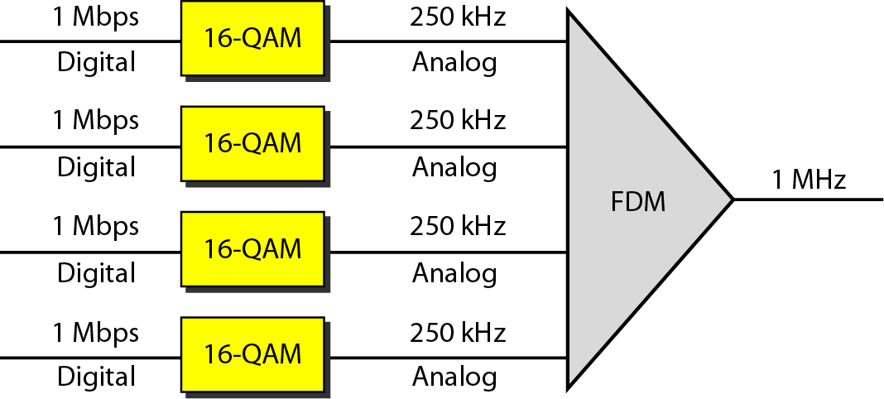
Figure 6.8 Example 6.3
6.16

Slide 17
Example 6.4
The Advanced Mobile Phone System (AMPS) uses two bands. The first band of 824 to 849 MHz is used for sending, and 869 to 894 MHz is used for receiving. Each user has a bandwidth of 30 kHz in each direction. How many people can use their cellular phones simultaneously?
Solution
Each band is 25 MHz. If we divide 25 MHz by 30 kHz, we get 833.33. In reality, the band is divided into 832 channels. Of these, 42 channels are used for control, which means only 790 channels are available for cellular phone users.
6.17

Slide 18
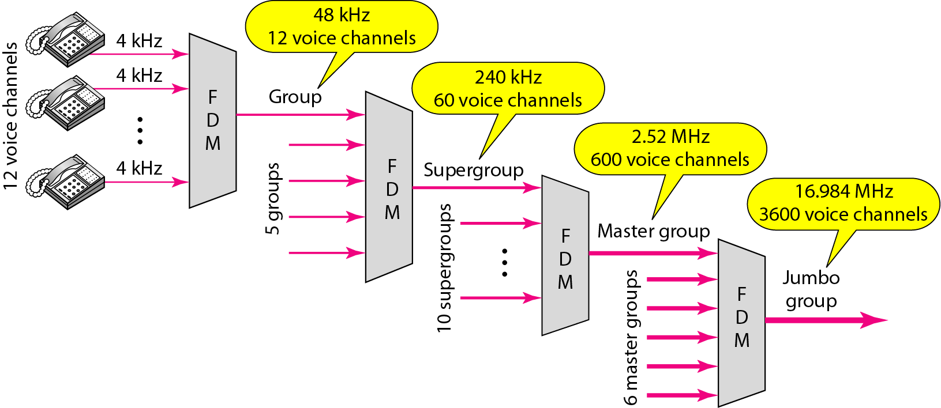
Figure 6.9 Analog hierarchy
6.18

Slide 19
Applications of FDM
A very common application of FDM is AM and FM radio broadcasting. Radio uses the air as the transmission medium. A special band from 530 to 1700 kHz is assigned to AM radio. All radio stations need to share this band. Each AM station needs 10 kHz of bandwidth. Each station uses a different carrier frequency, which means it is shifting its signal and multiplexing. The signal that goes to the air is a combination of signals. A receiver receives all these signals, but filters (by tuning) only the one which is desired. Without multiplexing, only one AM station could broadcast to the common link, the air.
The situation is similar in FM broadcasting.FM has a wider band of 88 to 108 MHz because each station needs a bandwidth of 200 kHz.
Another common use of FDM is in television broadcasting. Each TV channel has its own bandwidth of 6 MHz.
The first generation of cellular telephones also uses FDM. Each user is assigned two 30-kHz channels, one for sending voice and the other for receiving. The voice signal, which has a bandwidth of 3 kHz (from 300 to 3300 Hz). Therefore, each user is given, by the base station, a 60-kHz bandwidth in a range available at the time of the call.
6.19

Slide 20
Wavelength-division multiplexing
WDM is an analog multiplexing technique to combine optical signals.
6.20

Slide 21
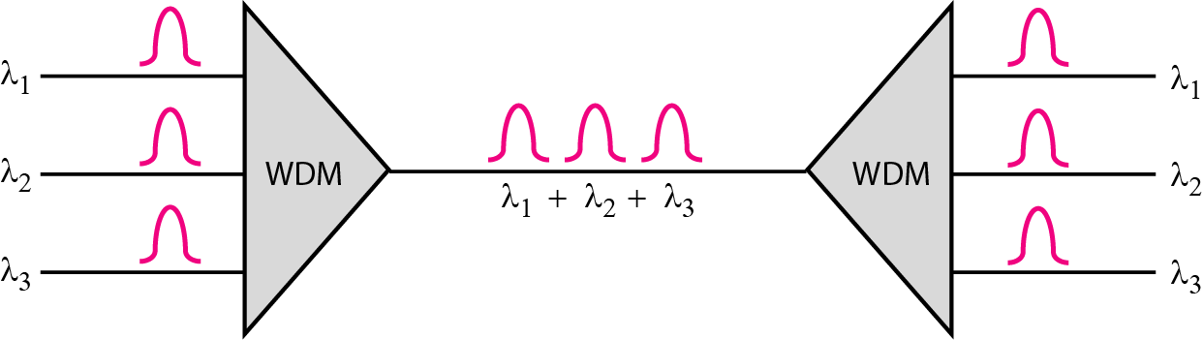
Figure 6.10 Wavelength-division multiplexing (WDM)
6.21

Slide 22
Wavelength-division multiplexing
a prism bends a beam of light based on the angle of incidence and the frequency.
Using this technique, a multiplexer can be made to combine several input beams of light, each containing a narrow band of frequencies, into one output beam of a wider band of frequencies. A demultiplexer can also be made to reverse the process.
6.22

Slide 23
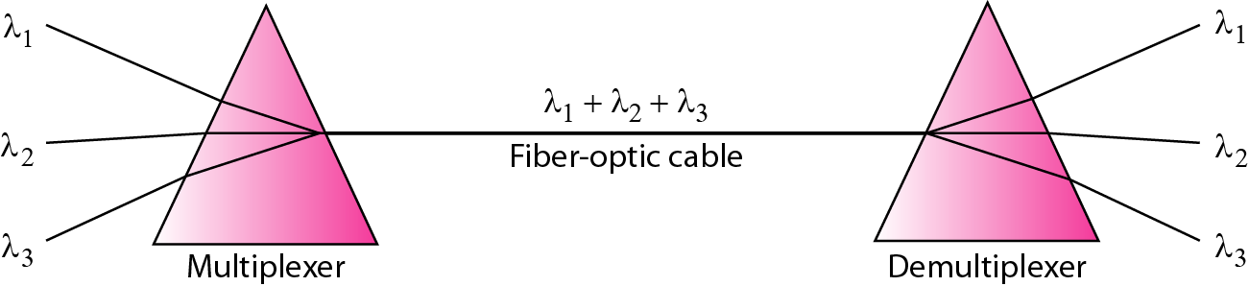
Figure 6.11 Prisms in wavelength-division multiplexing and demultiplexing
6.23

Slide 24
Time-division multiplexing
TDM is a digital multiplexing technique for combining several low-rate digital channels into one high-rate one.
6.24

Slide 25
Time-division multiplexing(TDM)
Time-division multiplexing (TDM) is a digital multiplexing technique that allows several connections to share the high bandwidth of a link.
Each connection occupies a portion of time in the link.
As TDM is, in principle, a digital multiplexing technique: this does not mean that the sources cannot produce analog data; analog data can be sampled, changed to digital data, and then multiplexed by using TDM.
We can divide TDM into two different schemes: synchronous and statistical.
In synchronous TDM, each input connection has an allotment in the output even if it is not sending data.
6.25

Slide 26
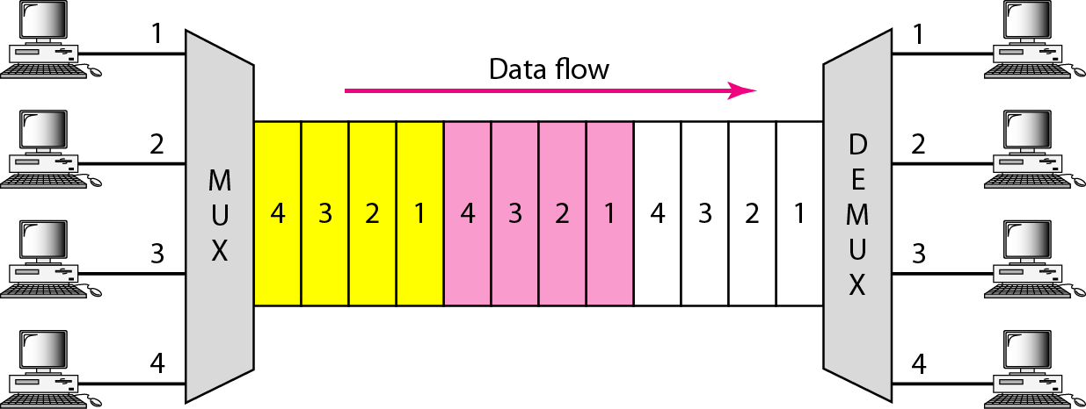
Figure 6.12 Time-division multiplexing(TDM)
6.26

Slide 27
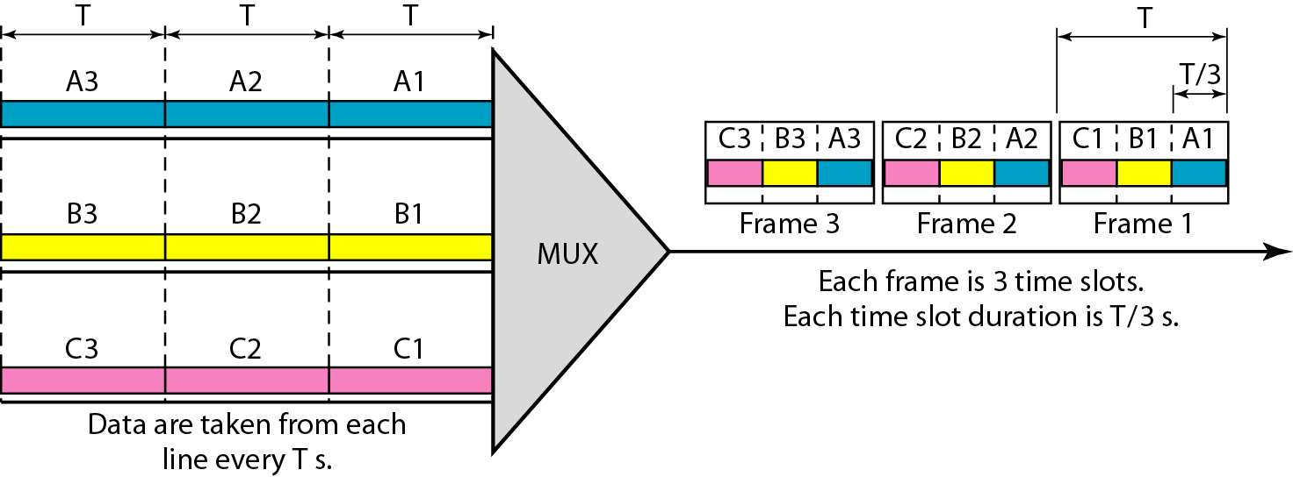
Figure 6.13 Synchronous time-division multiplexing
6.27

Slide 28
Synchronous time-division multiplexing
The data flow of each input connection is divided into units, where each input occupies one input time slot.
A unit can be 1 bit, one character, or one block of data.
Each input unit becomes one output unit and occupies one output time slot.
The duration of an output time slot is n times shorter than the duration of an input time slot. If an input time slot is T s, the output time slot is T/n s, and duration of each frame is T. where n is the number of input connections.
The data rate of the link is n times faster.
6.28

Slide 29
Note
In synchronous TDM, the data rate of the link is n times faster, and the unit duration is n times shorter.
6.29

Slide 30
Example 6.5
In Figure 6.13, the data rate for each one of the 3 input connection is 1 kbps. If 1 bit at a time is multiplexed (a unit is 1 bit), what is the duration of (a) each input slot, (b) each output slot, and (c) each frame?
Solution
We can answer the questions as follows:
a. The data rate of each input connection is 1 kbps. This means that the bit duration is 1/1000 s or 1 ms. The duration of the input time slot is 1 ms (same as bit duration).
6.30

Slide 31
Example 6.5 (continued)
b. The duration of each output time slot is one-third of the input time slot. This means that the duration of the output time slot is 1/3 ms.
c. Each frame carries three output time slots. So the duration of a frame is 3 × 1/3 ms, or 1 ms.
Note: The duration of a frame is the same as the duration of an input unit.
6.31

Slide 32
Example 6.6
Figure 6.14 shows synchronous TDM with 4 1Mbps data stream inputs and one data stream for the output. The unit of data is 1 bit. Find (a) the input bit duration, (b) the output bit duration, (c) the output bit rate, and (d) the output frame rate.
Solution
We can answer the questions as follows:
a. The input bit duration is the inverse of the bit rate: 1/1 Mbps = 1 μs.
b. The output bit duration is one-fourth of the input bit duration, or ¼ μs.
6.32

Slide 33
Example 6.6 (continued)
c. The output bit rate is the inverse of the output bit duration or 1/(4μs) or 4 Mbps. This can also be deduced from the fact that the output rate is 4 times as fast as any input rate; so the output rate = 4 × 1 Mbps = 4 Mbps.
d. The frame rate is always the same as any input rate. So the frame rate is 1,000,000 frames per second. Because we are sending 4 bits in each frame, we can verify the result of the previous question by multiplying the frame rate by the number of bits per frame.
6.33

Slide 34
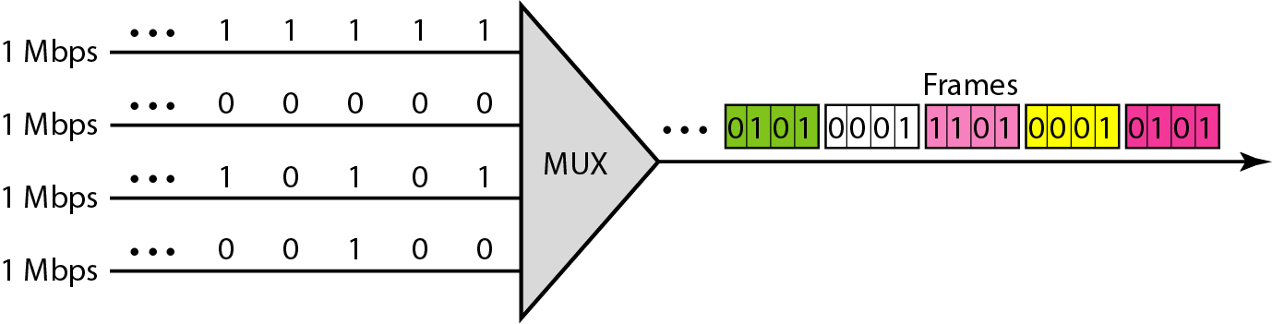
Figure 6.14 Example 6.6
6.34

Slide 35
Example 6.7
Four 1-kbps connections are multiplexed together. A unit is 1 bit. Find (a) the duration of 1 bit before multiplexing, (b) the transmission rate of the link, (c) the duration of a time slot, and (d) the duration of a frame.
Solution
We can answer the questions as follows:
a. The duration of 1 bit before multiplexing is 1 / 1 kbps, or 0.001 s (1 ms).
b. The rate of the link is 4 times the rate of a connection, or 4 kbps.
6.35

Slide 36
Example 6.7 (continued)
c. The duration of each time slot is one-fourth of the duration of each bit before multiplexing, or 1/4 ms or 250 μs. Note that we can also calculate this from the data rate of the link, 4 kbps. The bit duration is the inverse of the data rate, or 1/4 kbps or 250 μs.
d. The duration of a frame is always the same as the duration of a unit before multiplexing, or 1 ms. We can also calculate this in another way. Each frame in this case has four time slots. So the duration of a frame is 4 times 250 μs, or 1 ms.
6.36

Slide 37
Interleaving
The process of taking a group of bits from each input line for multiplexing is called interleaving.
On the multiplexing side, as the switch opens in front of a connection, that connection has the opportunity to send a unit onto the path. This process is called interleaving. On the demultiplexing side, as the switch opens in front of a connection, that connection has the opportunity to receive a unit from the path.
6.37

Slide 38
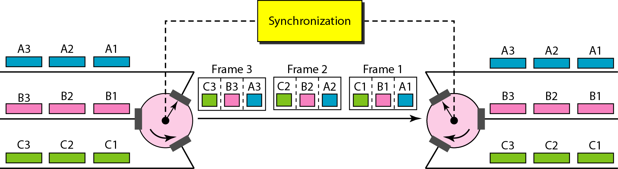
Figure 6.15 Interleaving
6.38

Slide 39
Example 6.8
Four channels are multiplexed using TDM. If each channel sends 100 bytes /s and we multiplex 1 byte per channel, show the frame traveling on the link, the size of the frame, the duration of a frame, the frame rate, and the bit rate for the link.
Solution
The multiplexer is shown in Figure 6.16. Each frame carries 1 byte from each channel; the size of each frame, therefore, is 4 bytes, or 32 bits. Because each channel is sending 100 bytes/s and a frame carries 1 byte from each channel, the frame rate must be 100 frames per second. The bit rate is 100 × 32, or 3200 bps.
6.39

Slide 40
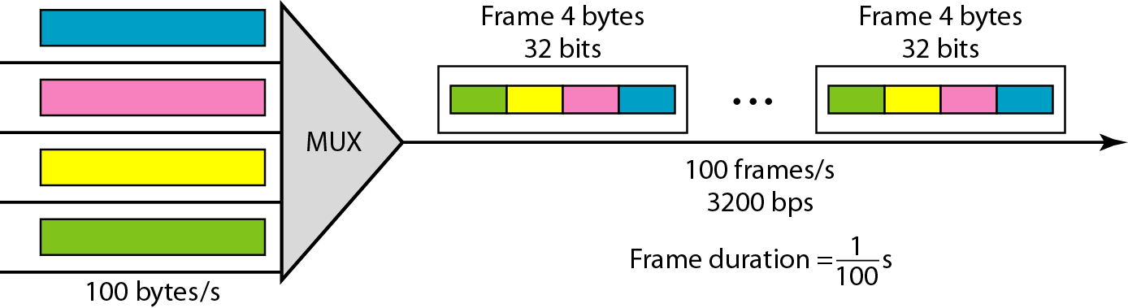
Figure 6.16 Example 6.8
6.40

Slide 41
Example 6.9
A multiplexer combines four 100-kbps channels using a time slot of 2 bits. Show the output with four arbitrary inputs. What is the frame rate? What is the frame duration? What is the bit rate? What is the bit duration?
Solution
Figure 6.17 shows the output (4x100kbps) for four arbitrary inputs. The link carries 400K/(2x4)=50,000 2x4=8bit frames per second. The frame duration is therefore 1/50,000 s or 20 μs. The bit duration on the output link is 1/400,000 s, or 2.5 μs.
6.41

Slide 42
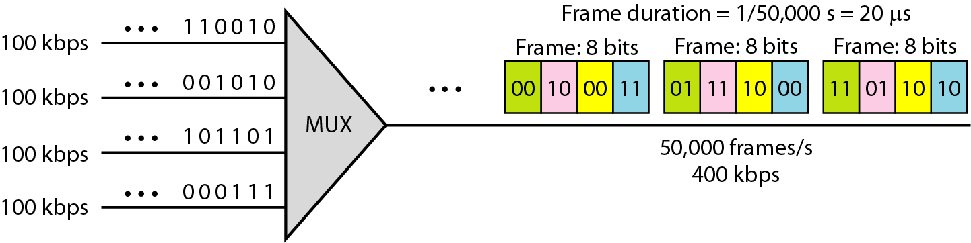
Figure 6.17 Example 6.9
6.42

Slide 43
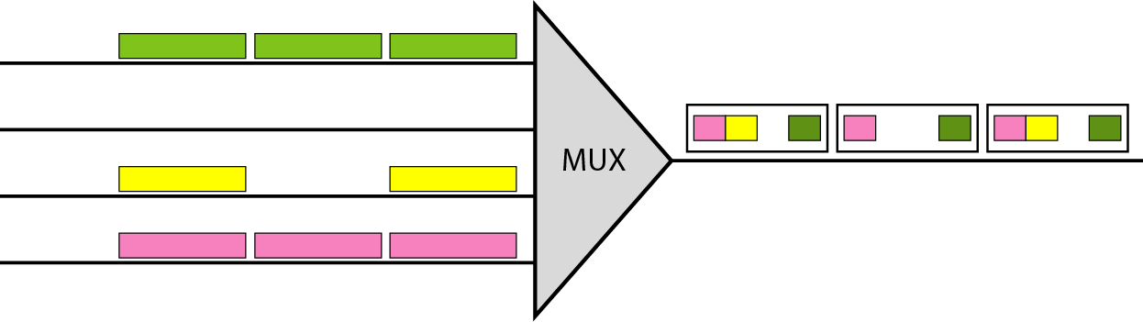
Figure 6.18 Empty slots
Synchronous TDM is not as efficient as it could be. If a source does not have data to
send, the corresponding slot in the output frame is empty.
In statistical TDM can improve the efficiency by removing the empty slots from the
frame.
6.43

Slide 44
Data Rate Management
One problem with TDM is how to handle a disparity in the input data rates.
Not all input links maybe have the same data rate.
There maybe several different input link speeds.
There are three strategies that can be used to overcome the data rate mismatch: multilevel, multislot and pulse stuffing.
6.44

Slide 45
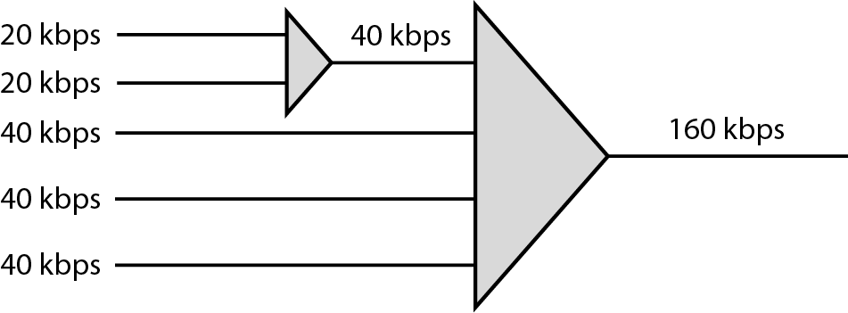
Figure 6.19 Multilevel multiplexing
Multilevel: used when the data rate of the input links are multiples of each other.
6.45

Slide 46
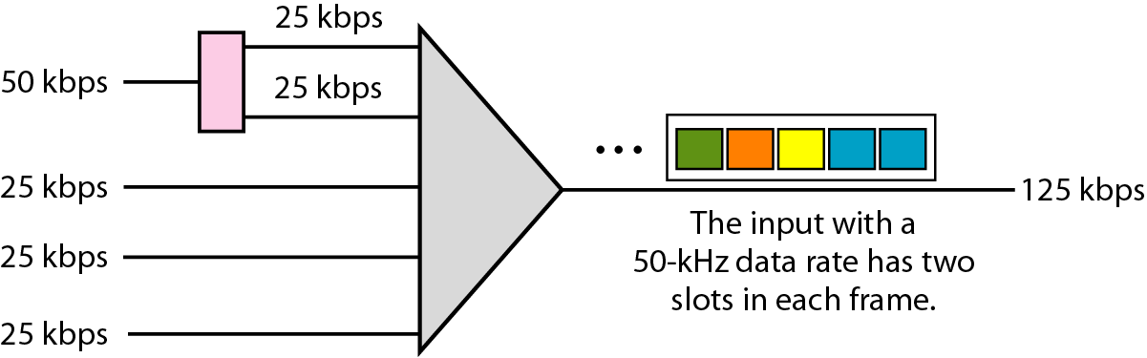
Figure 6.20 Multiple-slot multiplexing
Multislot: used when there is a GCD between the data rates. In Figure the input line with a 50-kbps data rate can be given two slots in the output. We insert a de-multiplexer in the line to
make two inputs out of one.
6.46

Slide 47
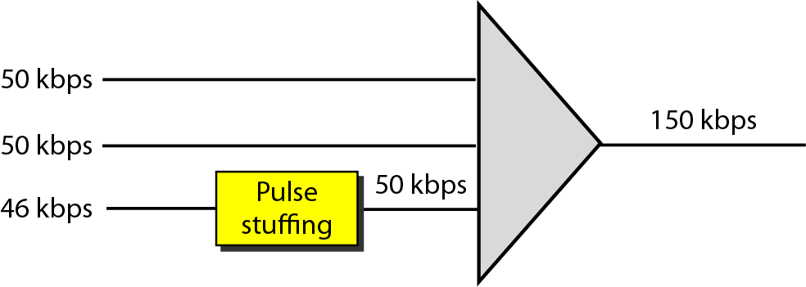
Figure 6.21 Pulse stuffing
Pulse Stuffing: used when there is no GCD between the links. The slowest speed link will be brought up to the speed of the other links by bit insertion, this is called pulse stuffing, bit padding, or bit stuffing.
6.47

Slide 48
Frame Synchronization
Synchronization between the multiplexer and demultiplexer is a major issue. If the multiplexer and the demultiplexer are not synchronized, a bit belonging to one channel may be received by the wrong channel.
For this reason, one or more synchronization bits are usually added to the beginning of each frame.
In most cases, this synchronization information consists of 1 bit per frame, alternating between 0 and 1.
6.48

Slide 49
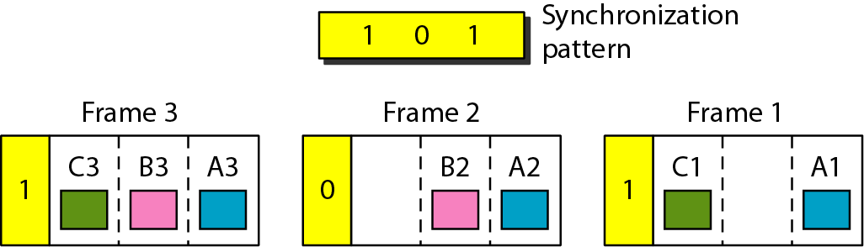
Figure 6.22 Framing bits
6.49

Slide 50
Example 6.10
We have four sources, each creating 250 8-bit characters per second. If the interleaved unit is a character and 1 synchronizing bit is added to each frame, find (a) the data rate of each source, (b) the duration of each character in each source, (c) the frame rate, (d) the duration of each frame, (e) the number of bits in each frame, and (f) the data rate of the link.
Solution
We can answer the questions as follows:
a. The data rate of each source is 250 × 8 = 2000 bps = 2 kbps.
6.50

Slide 51
Example 6.10 (continued)
b. Each source sends 250 characters per second; therefore, the duration of a character is 1/250 s, or 4 ms.
c. Each frame has one character from each source, which means the link needs to send 250 frames per second to keep the transmission rate of each source.
d. The duration of each frame is 1/250 s, or 4 ms. Note that the duration of each frame is the same as the duration of each character coming from each source.
e. Each frame carries 4 characters and 1 extra synchronizing bit. This means that each frame is 4 × 8 + 1 = 33 bits.
6.51

Slide 52
Example 6.11
Two channels, one with a bit rate of 100 kbps and another with a bit rate of 200 kbps, are to be multiplexed. How this can be achieved? What is the frame rate? What is the frame duration? What is the bit rate of the link?
Solution
We can allocate one slot to the first channel and two slots to the second channel. Each frame carries 3 bits. The frame rate is 100,000 frames per second because it carries 1 bit from the first channel. The bit rate is 100,000 frames/s × 3 bits per frame, or 300 kbps.
6.52

Slide 53
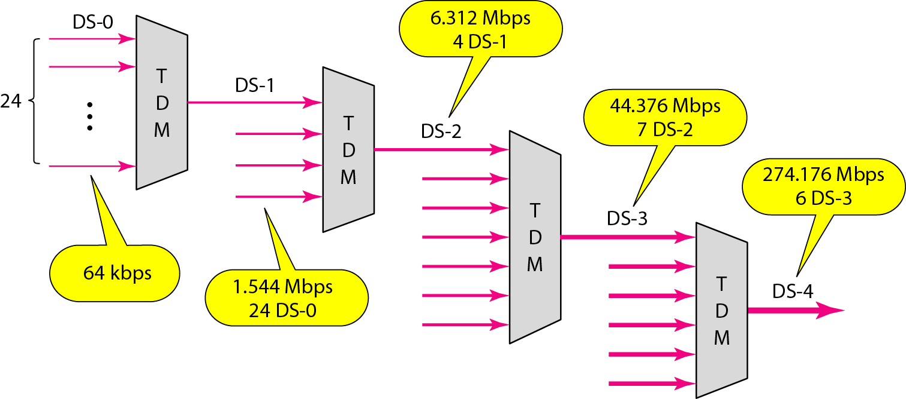
Figure 6.23 Digital hierarchy
digital signal (DS) service or digital hierarchy. Figure 6.23 shows the data rates supported by each level.
6.53

Slide 54
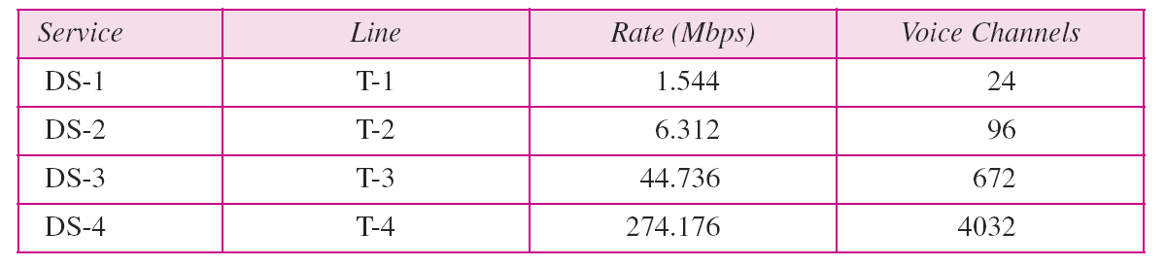
T Lines
DS-0, DS-1, and so on are the names of services. To implement those services, the telephone companies use T lines (T-1 to T-4). These are lines with capacities precisely matched to the data rates of the DS-1 to DS-4 services (see Table 6.1). So far only T-1 and T-3 lines are commercially available.
Table 6.1 DS and T line rates
6.54

Slide 55
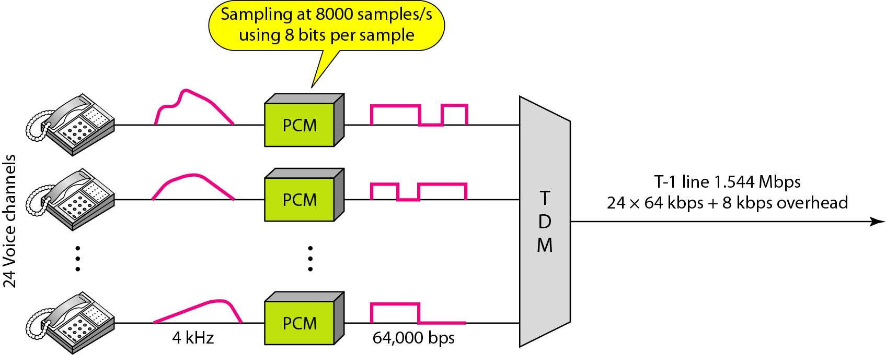
Figure 6.24 T-1 line for multiplexing telephone lines
6.55

Slide 56
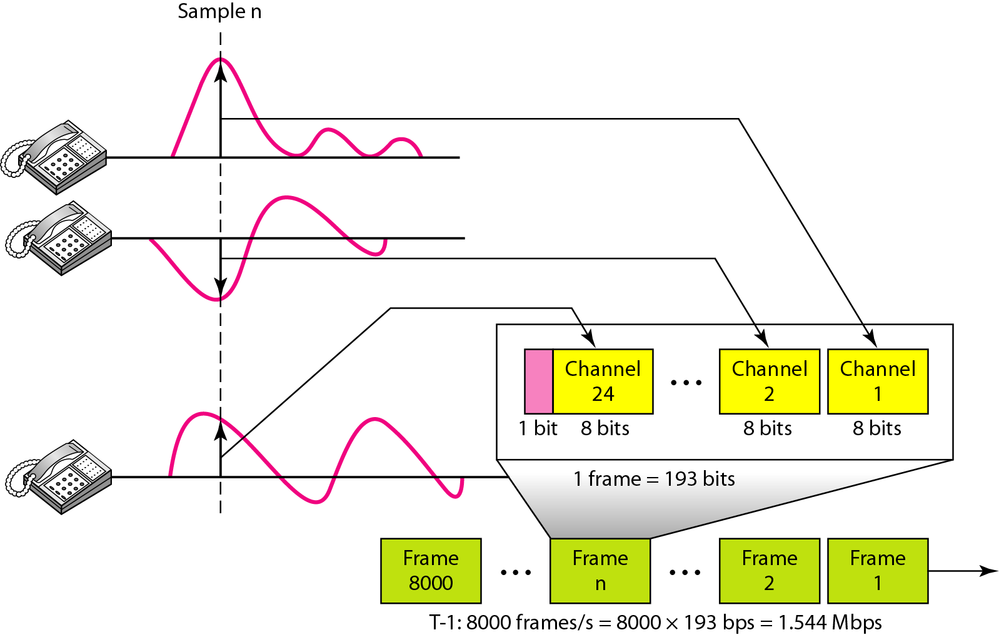
Figure 6.25 T-1 frame structure
6.56

Slide 57
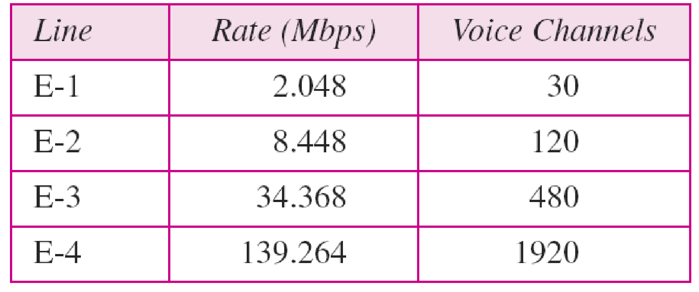
Europeans use a version of T lines called E lines. The two systems are conceptually
identical, but their capacities differ. Table 6.2 shows the E lines and their capacities.
Table 6.2 E line rates
6.57

Slide 58
Inefficient use of Bandwidth
Sometimes an input link may have no data to transmit.
When that happens, one or more slots on the output link will go unused.
That is wasteful of bandwidth.
6.58

Slide 59
Statistical Time-Division multiplexing
In statistical time-division multiplexing, slots are dynamically allocated to improve bandwidth efficiency.
Only when an input line has a slot’s worth of data to send is it given a slot in the output frame.
In statistical multiplexing, the number of slots in each frame is less than the number of input lines.
The multiplexer checks each input line in round robin fashion; it allocates a slot for an input line if the line has data to send; otherwise, it skips the line and checks the next line.
6.59

Slide 60
Statistical Time-Division multiplexing
Addressing
An output slot in synchronous TDM is totally occupied by data; in statistical TDM, a slot needs to carry data as well as the address of the destination.
In synchronous TDM, there is no need for addressing;
In statistical multiplexing, there is no fixed relationship between the inputs and outputs because there are no pre assigned or reserved slots.
We need to include the address of the receiver inside each slot to show where it is to be delivered.
Slot Size
No Synchronization Bit
Bandwidth
6.60

Slide 61
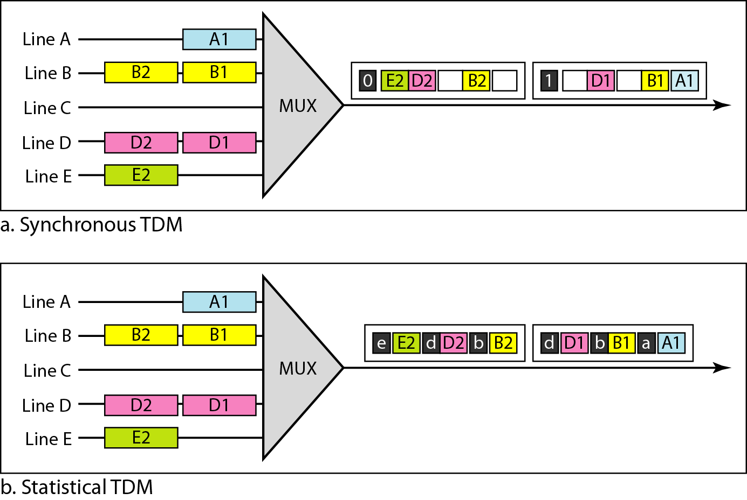
Figure 6.26 TDM slot comparison
6.61

Slide 62

6.62

Slide 63
6-1 SPREAD SPECTRUM
In spread spectrum (SS), we combine signals from different sources to fit into a larger bandwidth, but our goals are to prevent eavesdropping and jamming. To achieve these goals, spread spectrum techniques add redundancy.
Topics discussed in this section:
Frequency Hopping Spread Spectrum (FHSS)
Direct Sequence Spread Spectrum (DSSS)
6.63

Slide 64
Spread spectrum
Spread spectrum(SS), combine signals from different sources to fit into a larger bandwidth.
Spread spectrum is designed to be used in wireless applications.
In wireless applications, the stations (air or a vacuum) must be able to share the medium without interception by an eavesdropper and without being subject to jamming from a malicious intruder.
To achieve these goals, spread spectrum techniques add redundancy; they spread the original spectrum needed for each station.
6.64

Slide 65
Spread spectrum
If the required bandwidth for each stationis B, spread spectrum expands it to Bss, such that
Bss >> B.
The expanded bandwidth allows the source to wrap its message in a protective envelope for a more secure transmission.
Signals are spread with different codes so that they can be separated at the receivers.
Signals can be spread in the frequency domain or in the time domain.
6.65

Slide 66
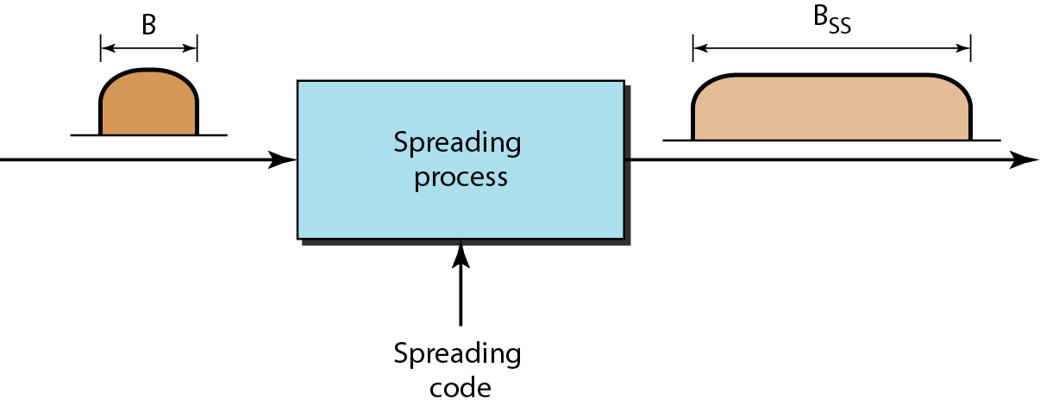
Figure 6.27 Spread spectrum
6.66

Slide 67
Spread spectrum
Spread spectrum achieves its goals through two principles:
The bandwidth allocated to each station needs to be, by far, larger than what is needed. This allows redundancy.
2. The expanding of the original bandwidth B to the bandwidth Bss must be done by a process that is independent of the original signal. In other words, the spreading process occurs after the signal is created by the source.
6.67

Slide 68
Frequency hopping spread spectrum (FHSS)
This technique uses M different carrier frequencies to modulated by the source signal.
Even though M different carrier frequencies are used in the long run, the modulation is done using one carrier frequency at a time,
The bandwidth occupied by a source after spreading is BFHSS >> B.
6.68

Slide 69
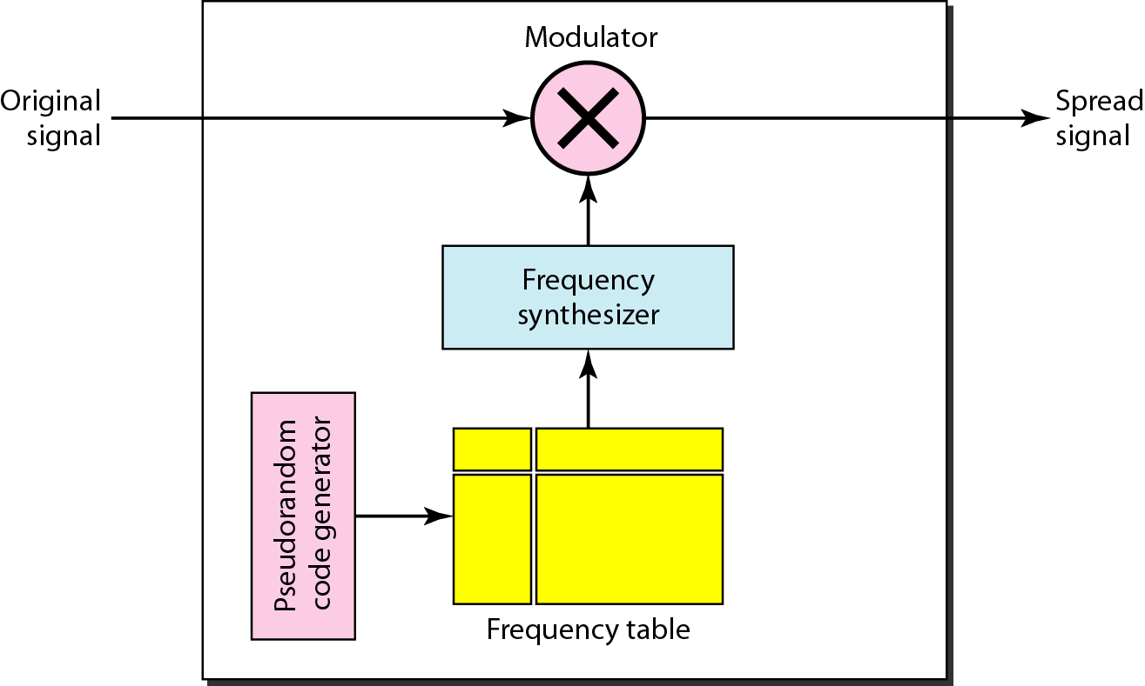
Figure 6.28 Frequency hopping spread spectrum (FHSS)
A pseudorandom code generator, creates a k-bit pattern for every hopping period T_{h}. The frequency table uses the pattern to find the frequency to be used for this hopping period and passes it to the frequency synthesizer. The frequency synthesizer creates a carrier signal of that frequency, and the source signal modulates the carrier signal.
6.69

Slide 70
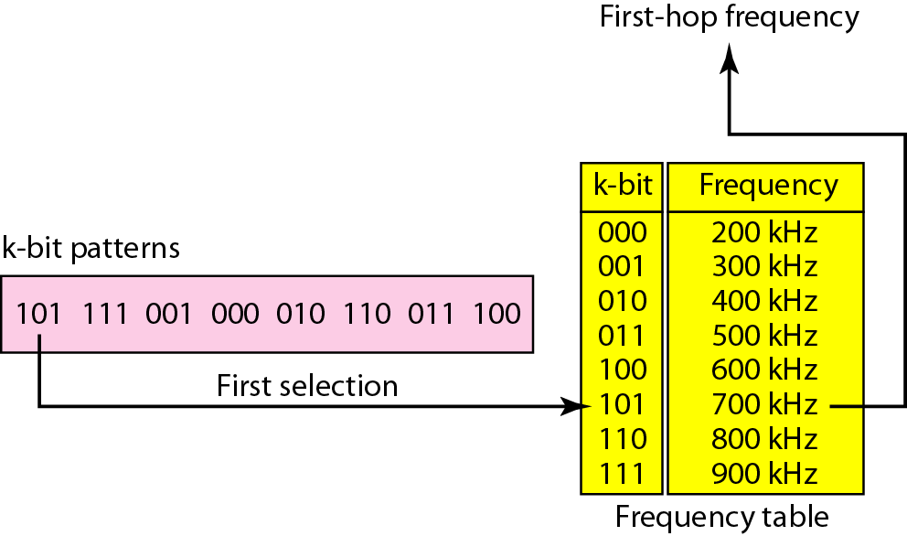
Figure 6.29 Frequency selection in FHSS
6.70

Slide 71
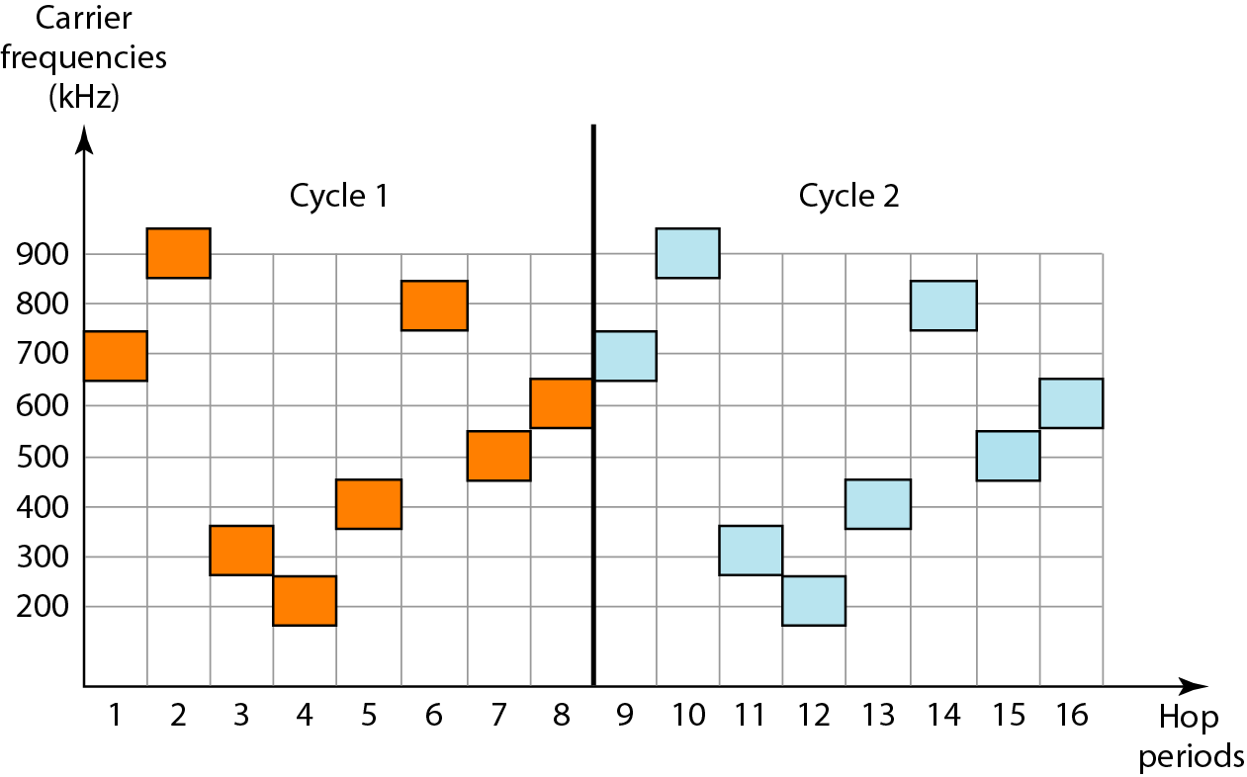
Figure 6.30 FHSS cycles
The pattern is pseudo random and hence it is repeated after in each cycle
6.71

Slide 72
How dose FHSS Accomplish the goals of Spread Spectrum
If there are many k-bit patterns and the hopping period is short, a sender and receiver can have privacy.
If an intruder tries to intercept the transmitted signal, she can only access a small piece of data because she does not know the spreading sequence to quickly adapt herself to the next hop.
FHSS scheme also has an antijamming property.
A malicious sender may be able to send noise to jam the signal for one hopping period (randomly),but not for the whole period.
6.72

Slide 73
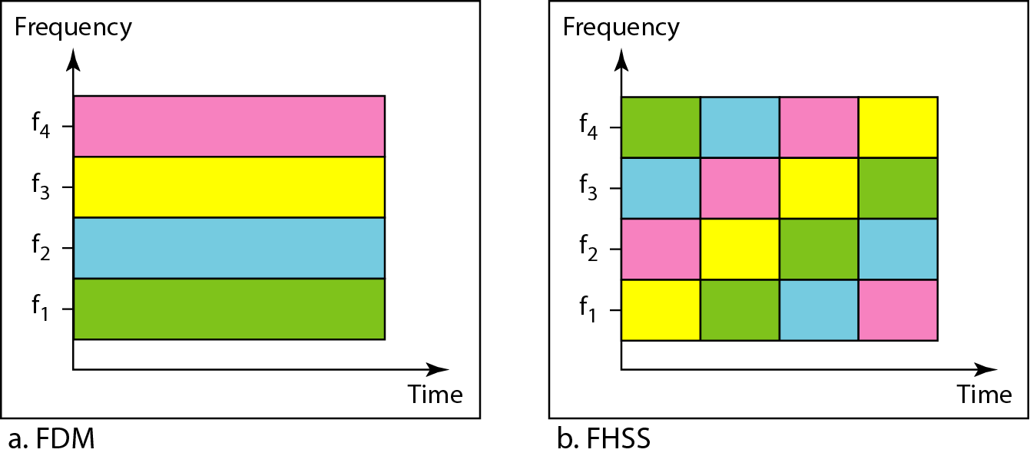
Figure 6.31 Bandwidth sharing
If the number of hopping frequencies is M, we can multiplex M channels into one by using the same Bss bandwidth.
In FDM, each station uses 1/M of the bandwidth, but the allocation is fixed; in FHSS, each station uses 1/M of the bandwidth, but the allocation changes hop to hop.
6.73

Slide 74
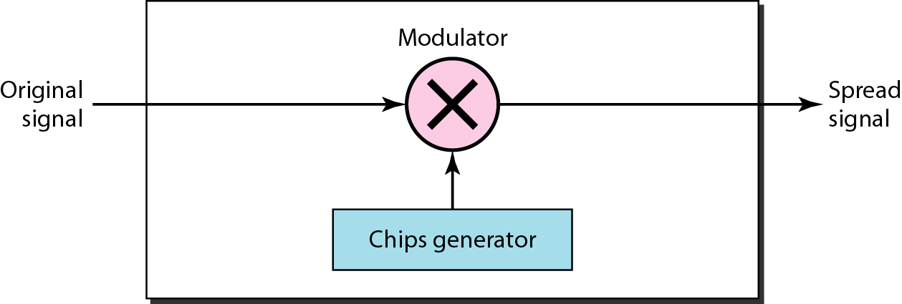
Figure 6.32 Direct Sequence Spread Spectrum DSSS
In DSSS, we replace each data bit with n bits (called chips) using a spreading code
6.74

Slide 75
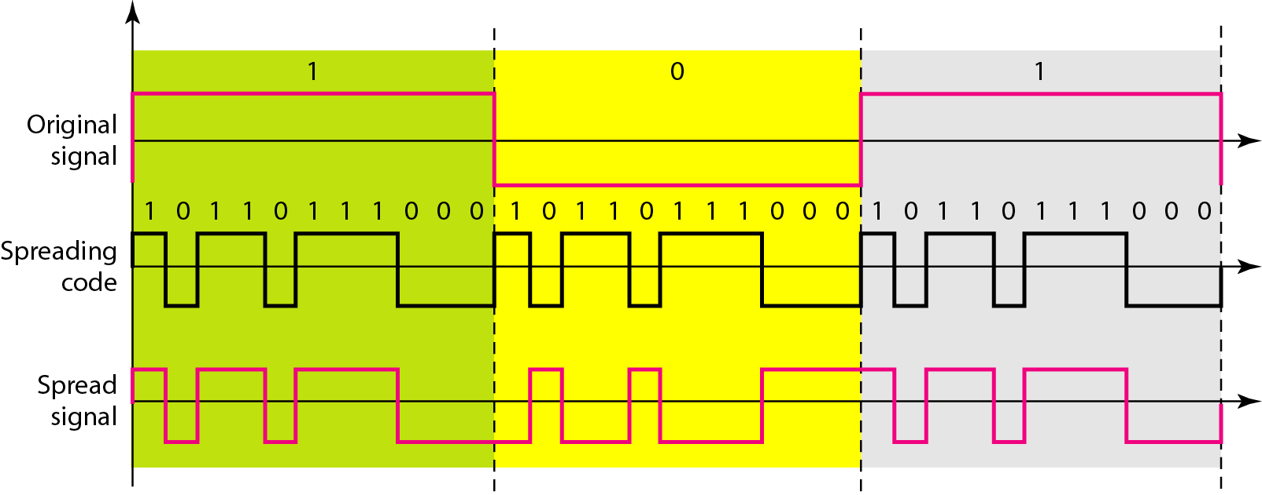
Figure 6.33 DSSS example
This example consider the sequence used in a wireless LAN, the famous barker sequence where n is 11.
If the original signal rate is N, the rate of the spread signal is 11N. This means that the required bandwidth for the spread signal is 11 times longer than the bandwidth of original signal.
6.75

Slide 76

6.76

